Slide 1

SAFETY SYSTEM OF LPG CONTAINER (Funded by Amrita Vishwa Vidyapeetham)
Name Pandu Konala, Nirmal Krishnan, Shree Hari
Under the guidance of:
Guide name: Mr.Sumesh A.K.
Designation: Asst. Professor, Computer Science, School of Engineering, Coimbatore
15CSE480 – Final Review
Department of Computer Science & Engineering Amrita School of Engineering, Coimbatore
1 / 19

Slide 2
Problem Statement
Liquid petroleum gas is a highly flammable material which has to be contained very securely , So to monitor the containment IOT is the reasonable solution.

Slide 3
Introduction
We all know how dangerous liquids and gases like LPG, CNG etc. are. They belong to class of liquids and gases termed as highly inflammable. Even the slightest rise in temperature should be seen with caution since if ever the temperature were to rise above the flash point of the gas or the liquid. So transporting such liquids/gases should be done with great caution. Even if all the necessary measures are taken to avoid the possibility of an explosion, there is still an element of risk to the person transporting the substance as well as to its surroundings.

Slide 4
Introduction (contd..)
With the recent advancements in the field of Internet of Things and electronics, we have access to sensors which can detect gases like LPG,CO,CH₄,the slightest variations in temperature etc. So with the help of these sensors coupled with efficient algorithms we will be able to detect whether the liquid has reached a point where it is no longer safe to transport it.So our project aims to develop an iot system that can determine the safety level beyond which it is no longer safe to transport the liquid. In such a situation the concerned authorities is notified by our system and suppression measures will turn on.

Slide 5
Related Works / Literature Survey / Current Status
S.No | Title | Publication Details | Comments/ Inferences
1. | SMART LPG SYSTEM | Published in International Research Journal of Engineering and Technology (IRJET) on | This paper gave us an insight into how to detect gas leakage and how to inform the consumer via a SMS.
2. | SMART GAS CYLINDER USING EMBEDDED SYSTEM | Published in INTERNATIONAL JOURNAL OF INNOVATIVE RESEARCH IN EEI on 2, February 2014 | This paper gave us an insight on the kind of preventive measures that can be taken to avoid an explosion during a gas leak (turning off the power).

Slide 6
Design ( HW / SW ) / Architecture…
Hardware Platform:
DHT11:-It is a temperature sensor .It is used to detect whether the liquid has reached its flash point.
MQ9:-The Grove - Gas Sensor(MQ9) module is useful for gas leakage detection (in home and industry). It is suitable for detecting LPG, CO, CH4.
Ultrasonic sensor:-It is used to measure the distance between the lid of the container and the liquid stored in it.
NodeMCU:-NodeMCU is an open source IoT platform. It includes firmware which runs on the ESP8266 Wi-Fi SoC from Espressif Systems, and hardware which is based on the ESP-12 module.
Notes:
Mininet is a network emulator which creates a network of virtual hosts, switches, controllers, and links. Mininet hosts run standard Linux network software, and its switches support OpenFlow for highly flexible custom routing and Software-Defined Networking.
ns-3 is a discrete-event network simulator, targeted primarily for research and educational use
OMNeT++ is an extensible, modular, component-based C++ simulation library and framework, primarily for building network simulators. "Network" is meant in a broader sense that includes wired and wireless communication networks, on-chip networks, queueing networks, and so on.

Slide 7
Design ( HW / SW ) / Architecture…(contd..)
Software Platform:
Arduino IDE:-The open-source Arduino Software makes it easy to write code and upload it to the board. It runs on Windows, Mac OS X, and Linux. The environment is written in Java and based on Processing and other open-source software. This software can be used with any Arduino board.
Adafruit Cloud:-Adafruit.io is a cloud service - that just means we run it for you and you don't have to manage it. You can connect to it over the Internet. It's meant primarily for storing and then retrieving data but it can do a lot more than just that.
IFTTT:-If This Then That, also known as IFTTT, is a free web-based service to create chains of simple conditional statements, called applets. An applet is triggered by changes that occur within other web services such as Gmail, Facebook, Telegram, Instagram, or Pinterest.

Slide 8
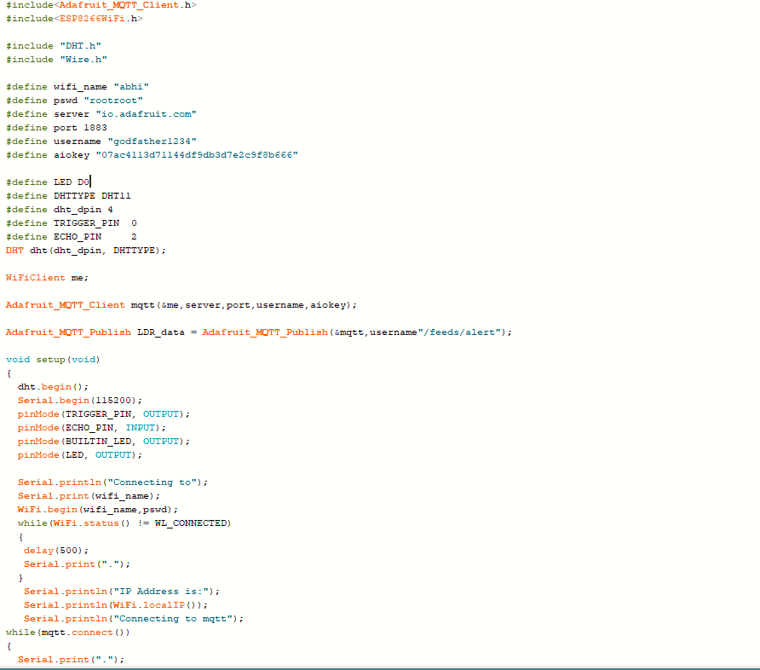
Screen shots of Hardware setup and Application Software screenshots
-->Software Screenshot:-

Slide 9
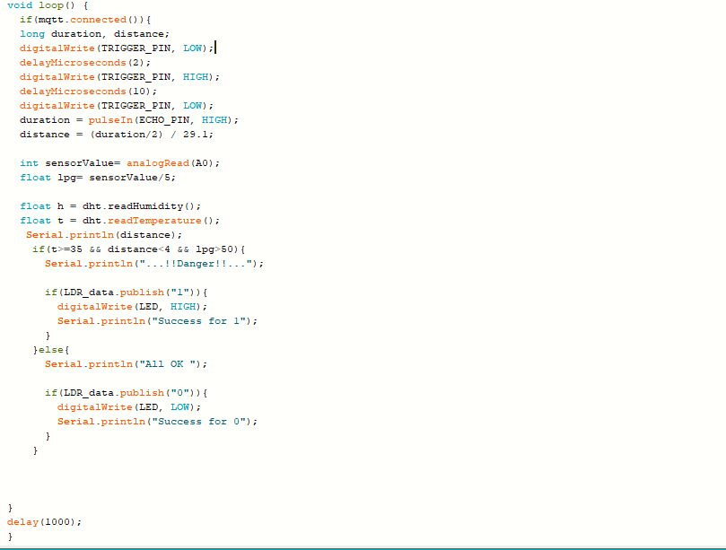
Continued….

Slide 10
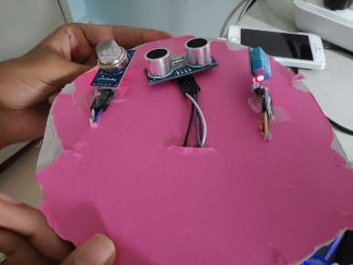
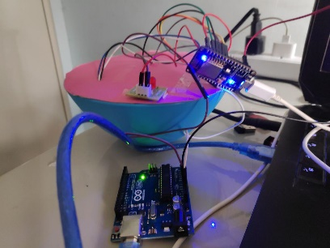
→Hardware Setup:-

Slide 11
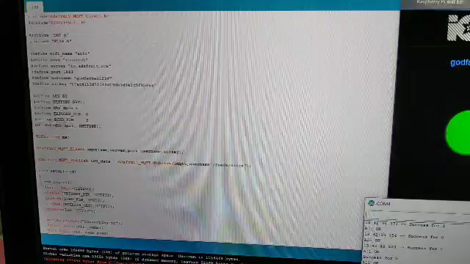
Outcomes of Project ( Max 2 Slide)

Slide 12
References
SMART LPG SYSTEM, International Research Journal of Engineering and Technology (IRJET), Volume: 03 Issue: 02 | Feb-2016
SMART GAS CYLINDER USING EMBEDDED SYSTEM, INTERNATIONAL JOURNAL OF INNOVATIVE RESEARCH IN ELECTRICAL, ELECTRONICS, INSTRUMENTATION AND CONTROL ENGINEERING Vol. 2, Issue 2, February 2014

Slide 13
Thank You

